Slide 1


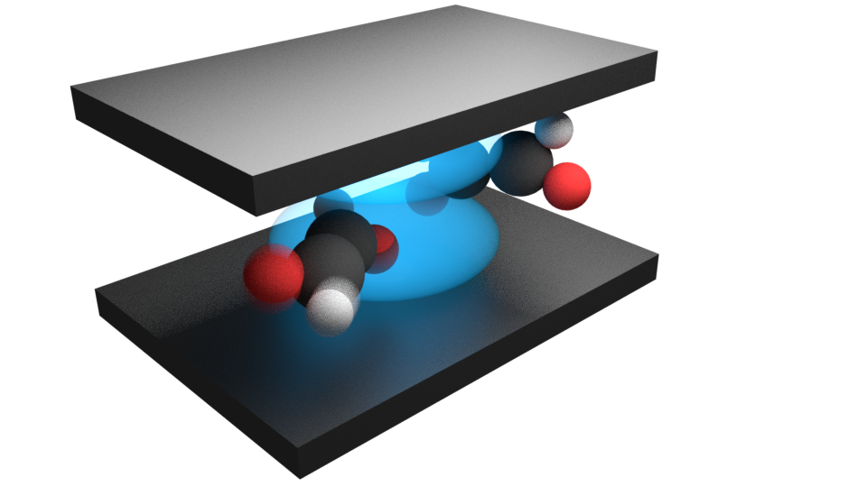
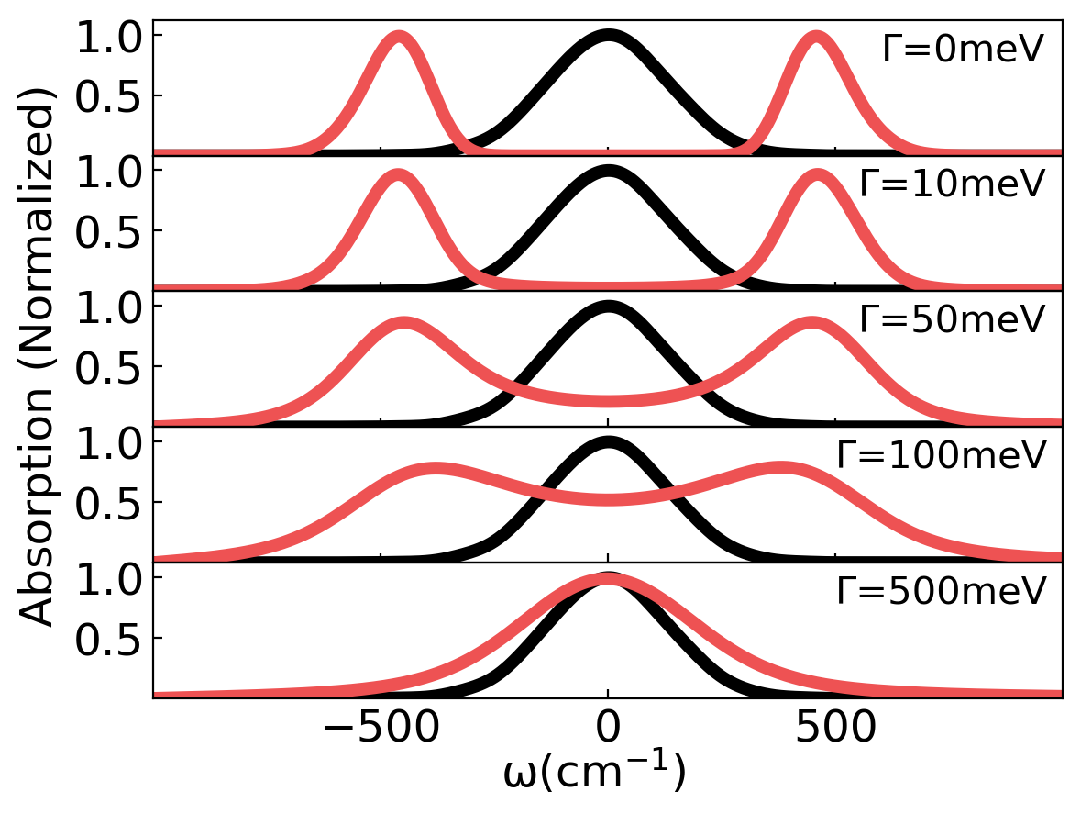
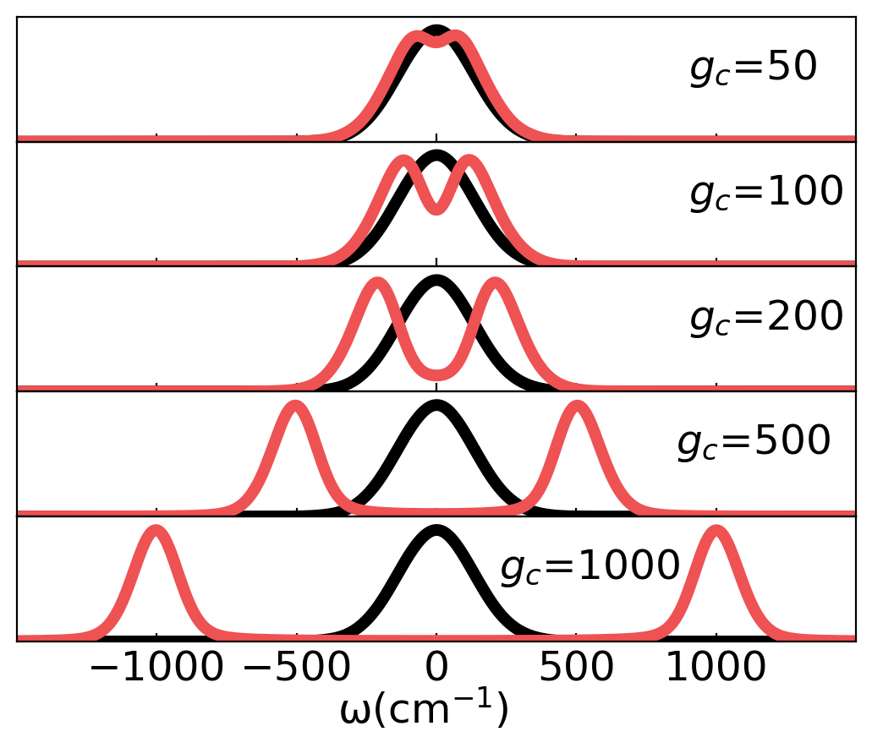
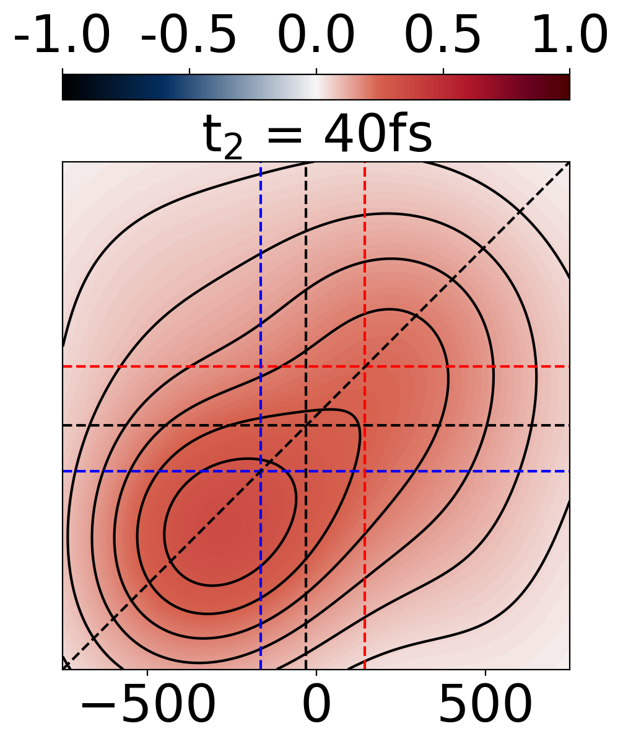
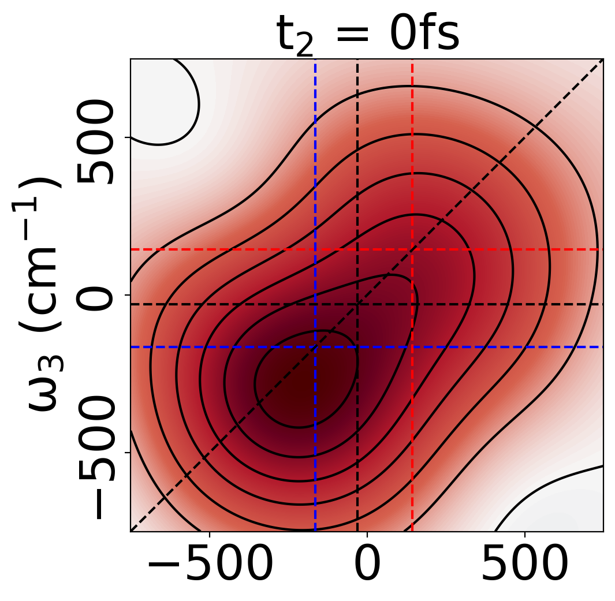
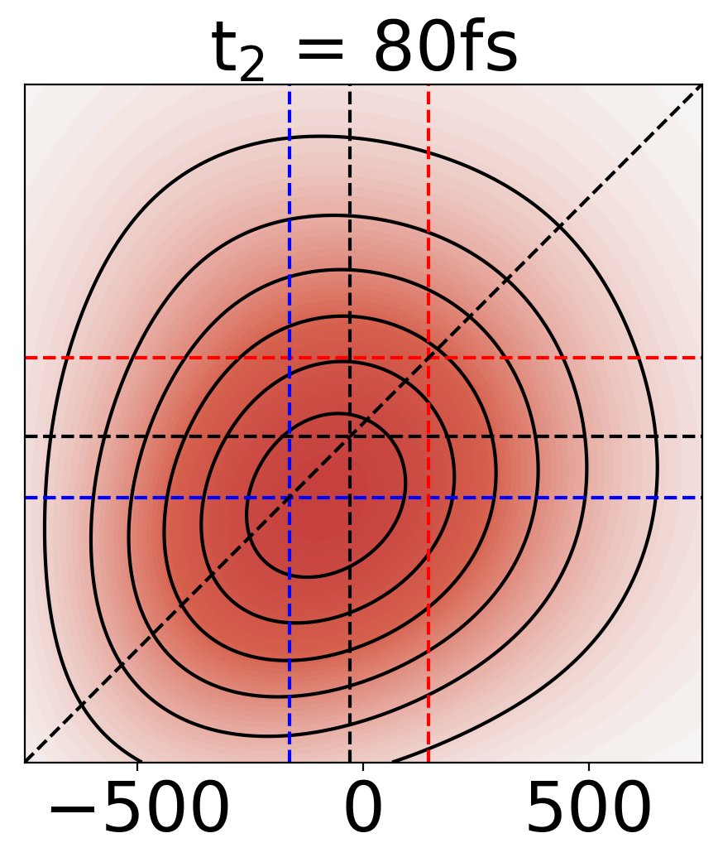
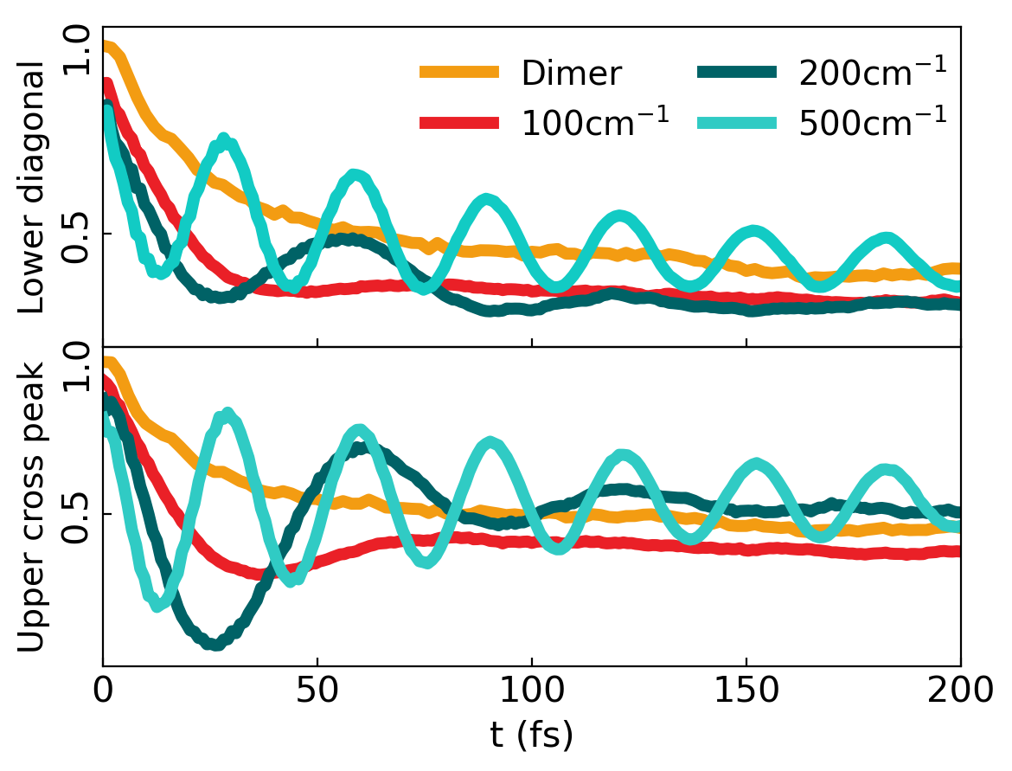
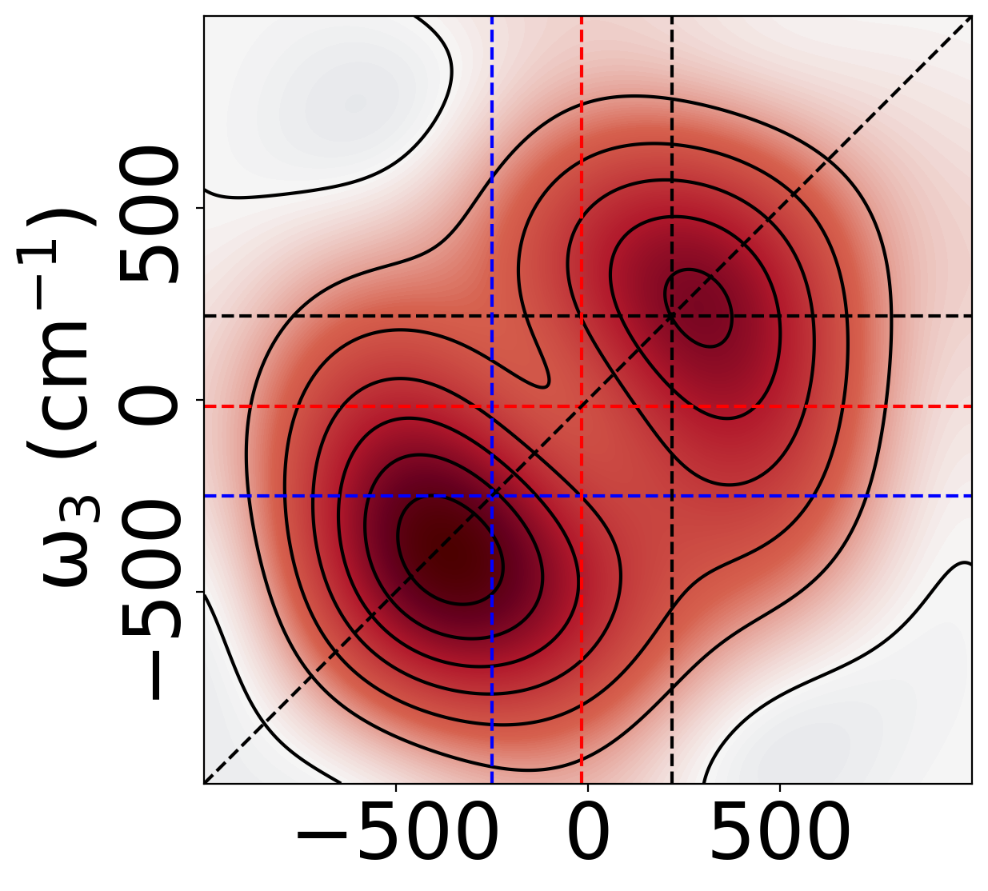
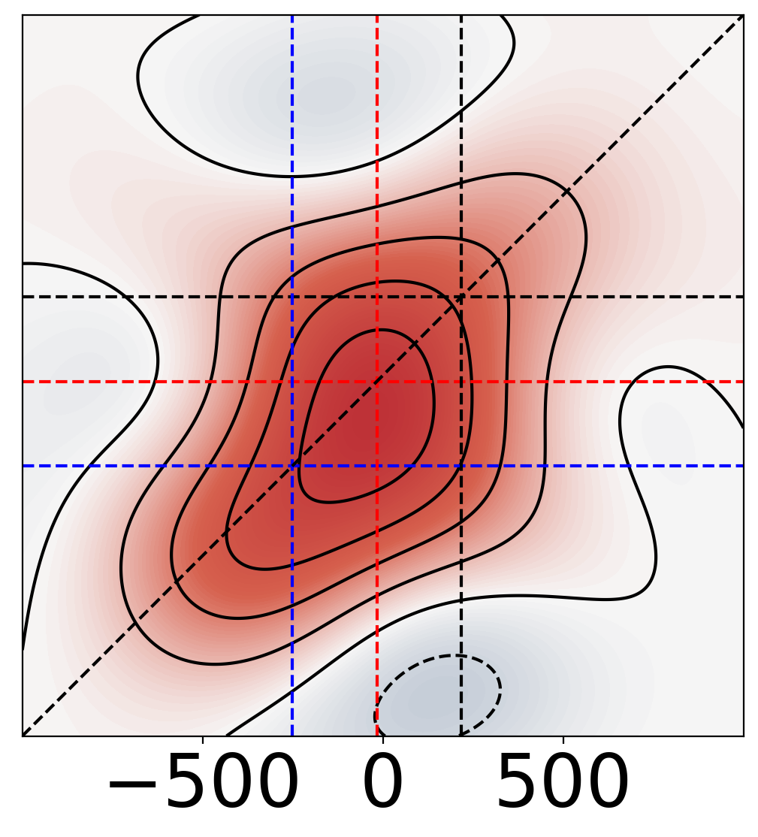
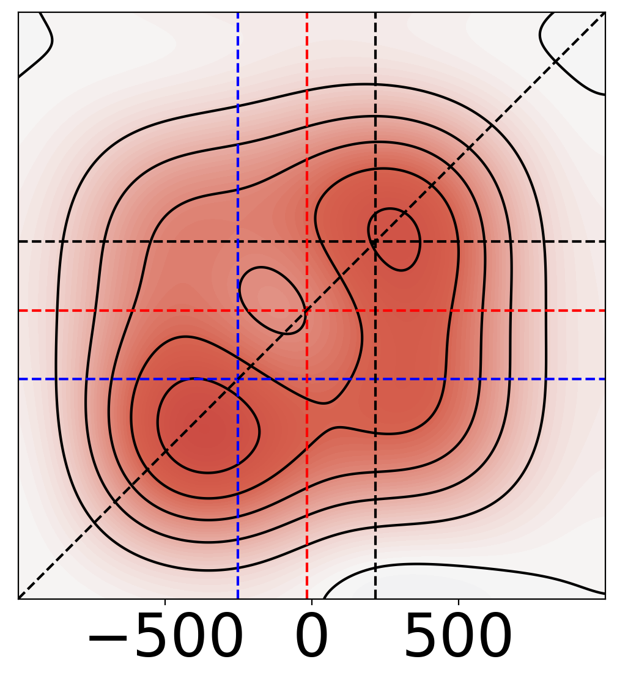
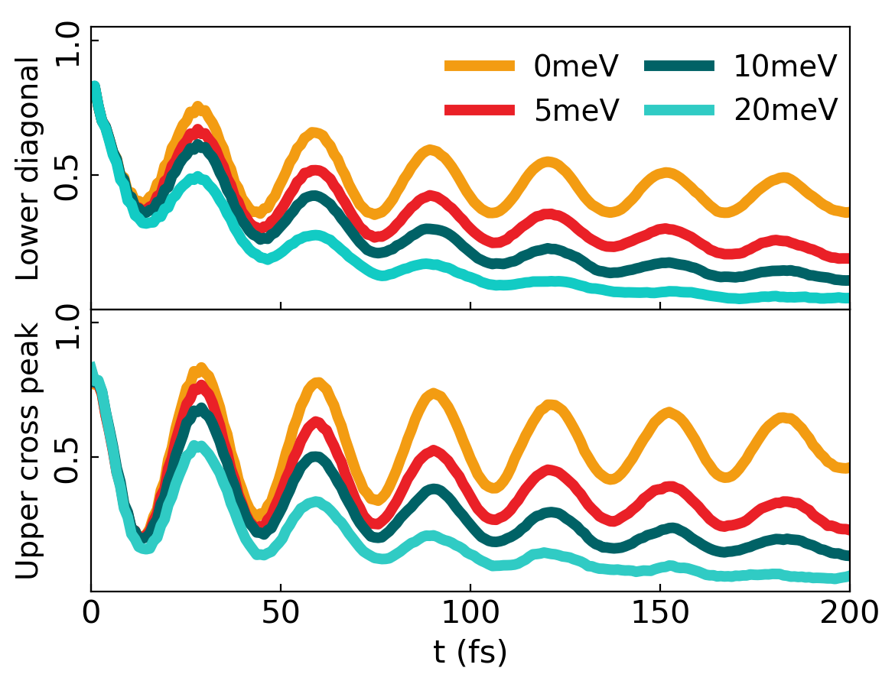
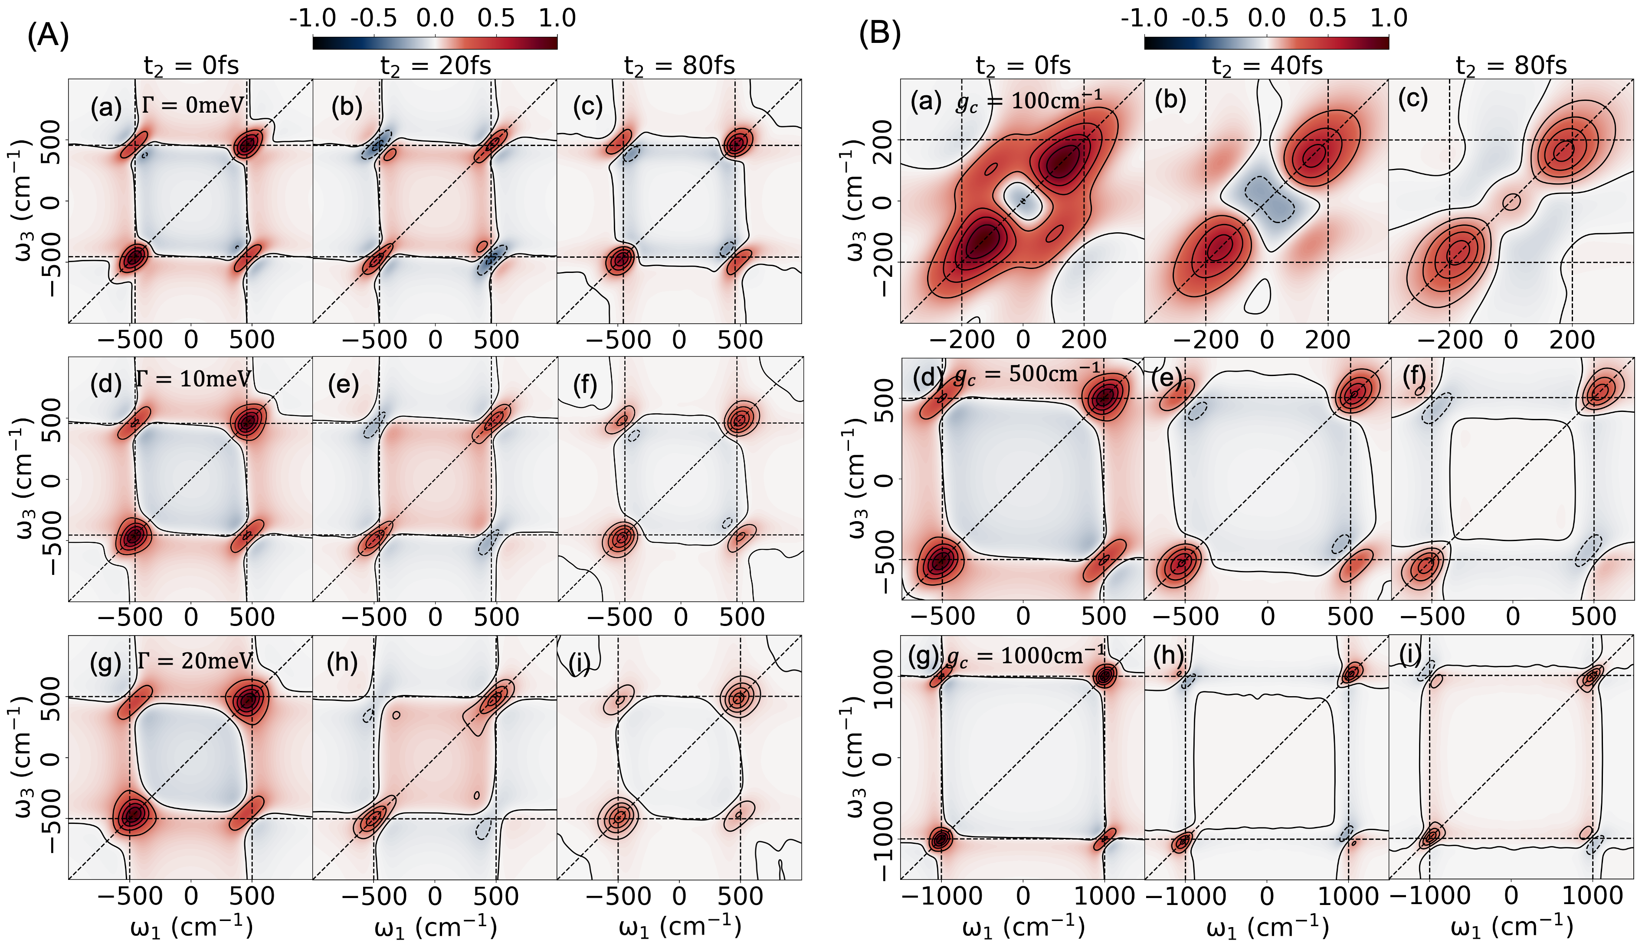
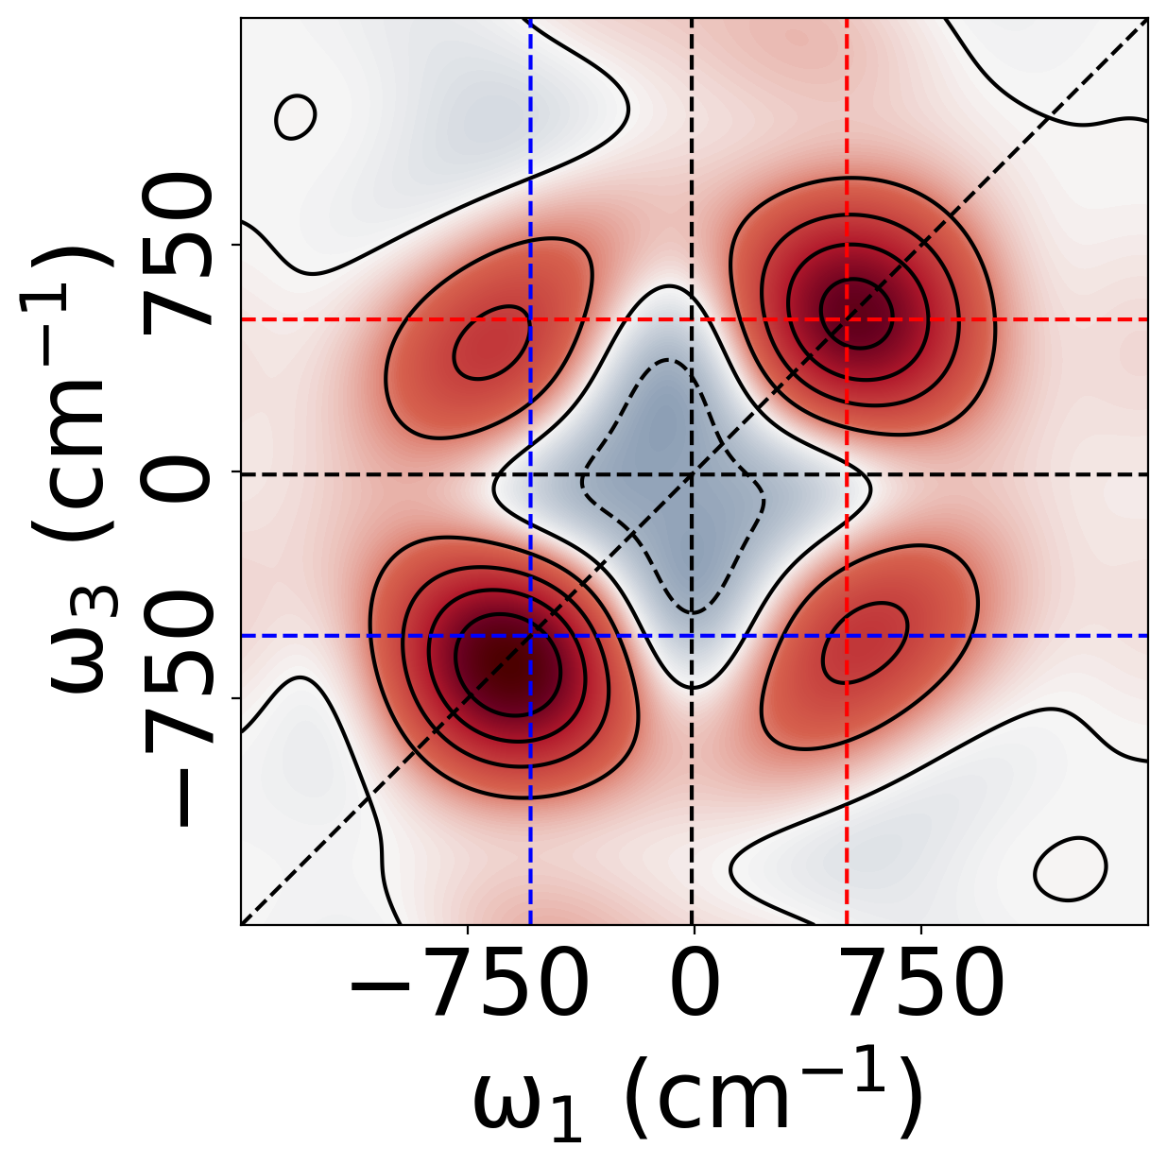
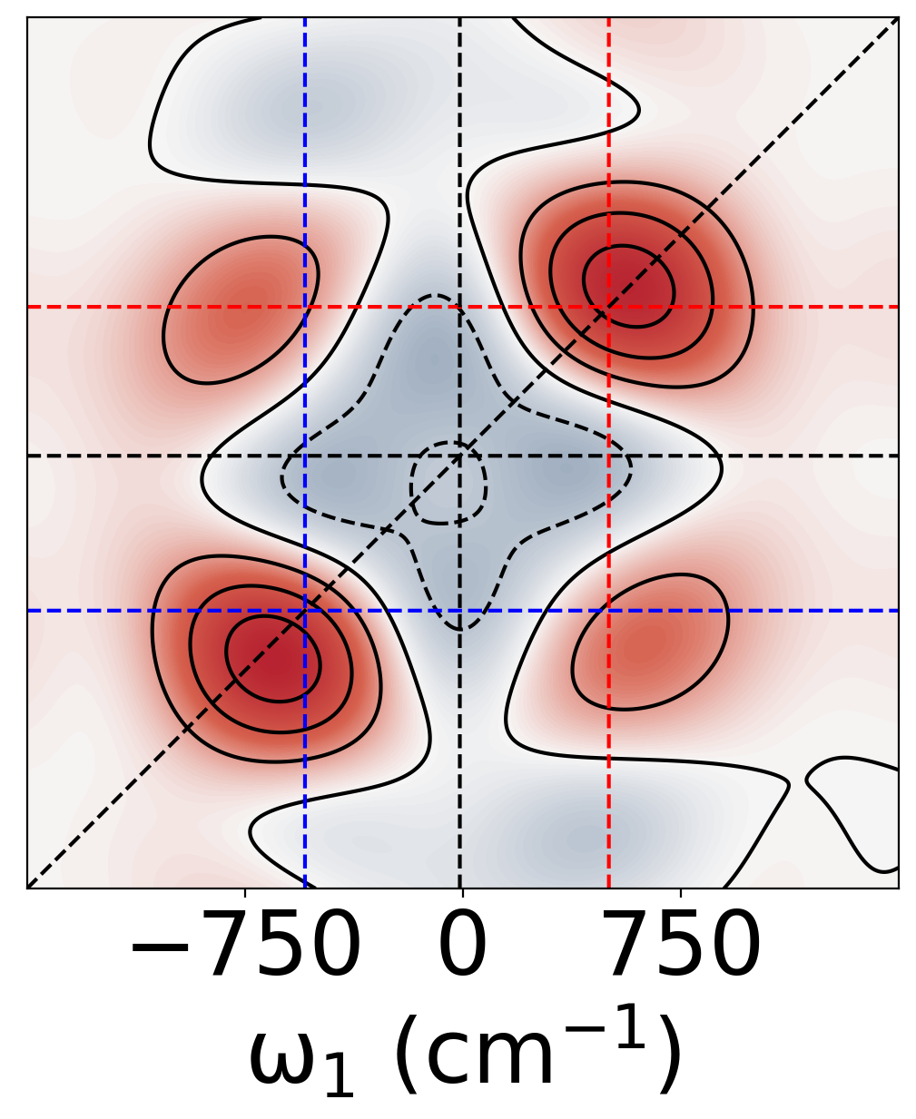
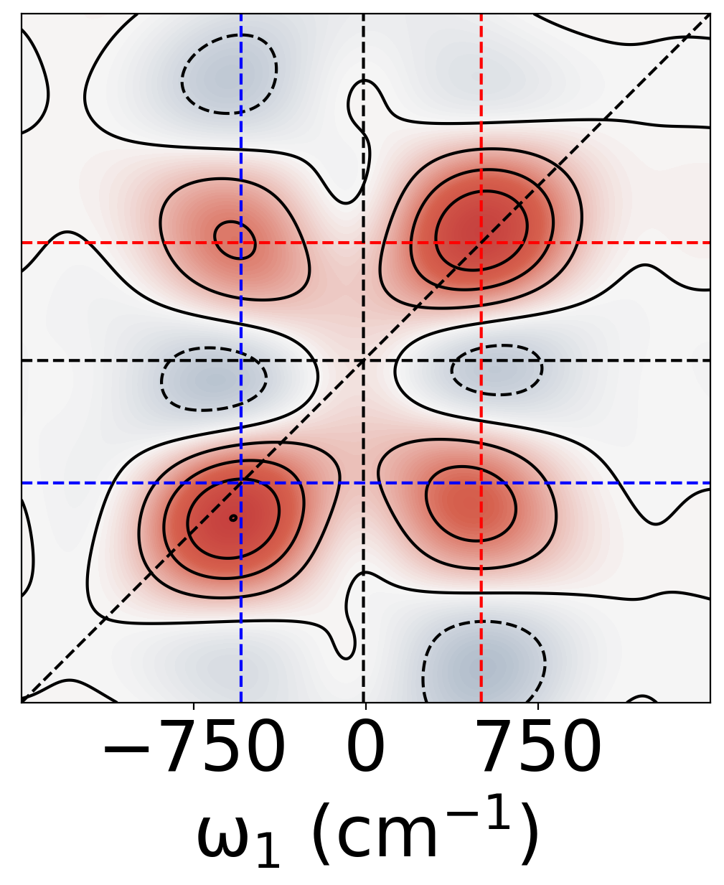
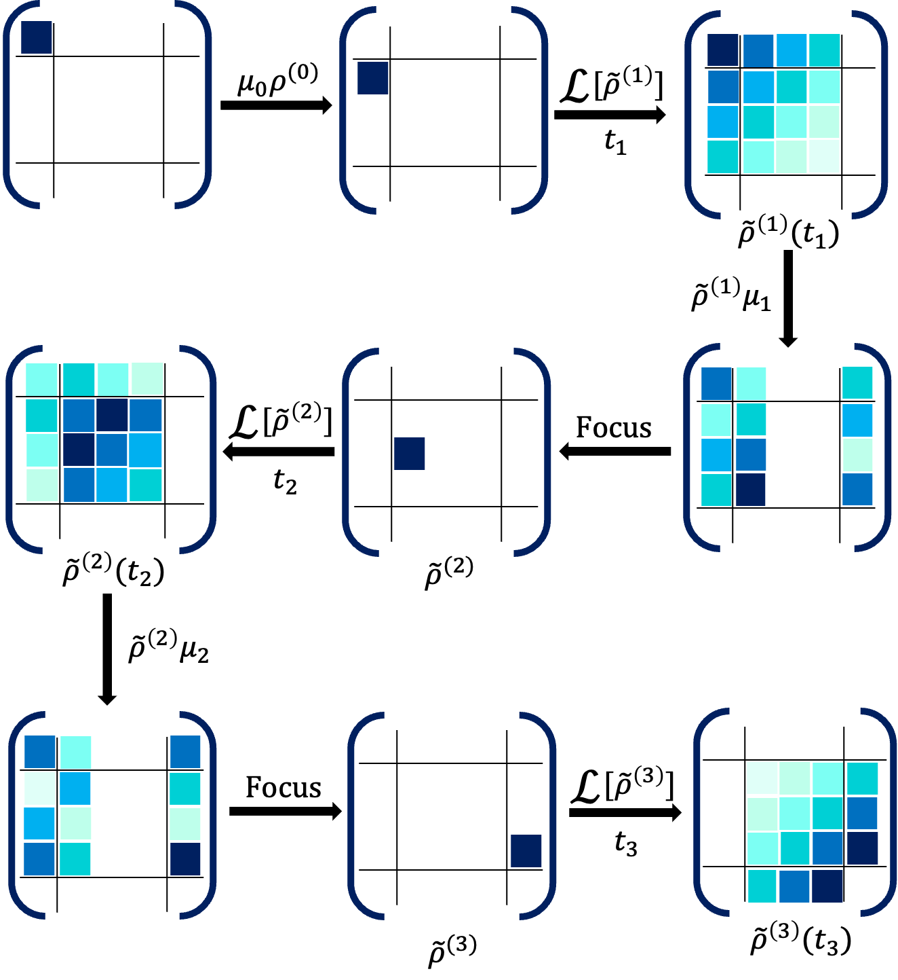
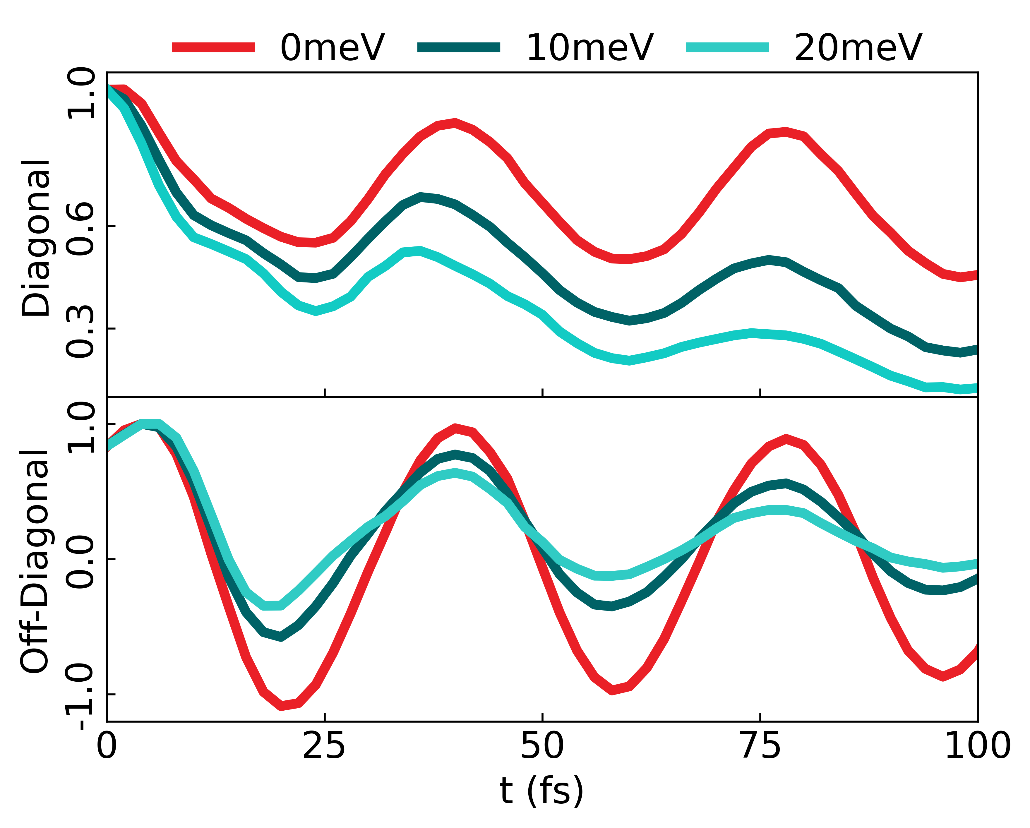
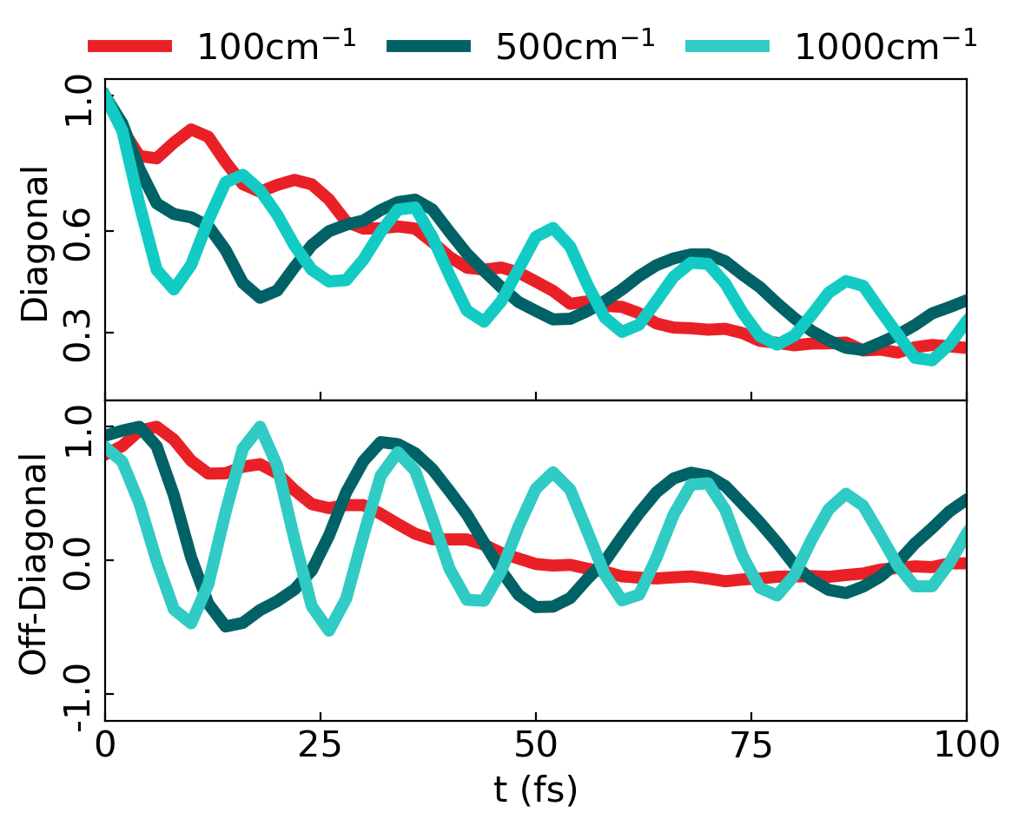

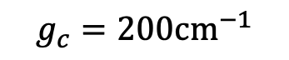

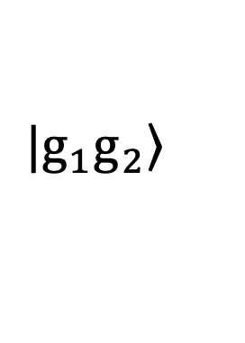
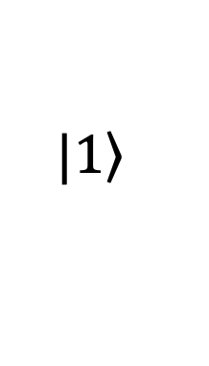
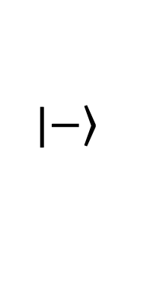
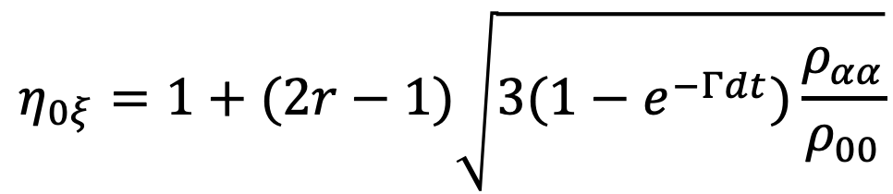
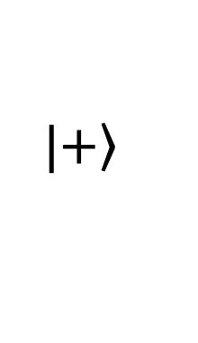
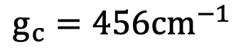
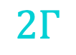
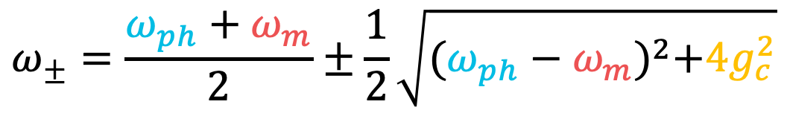
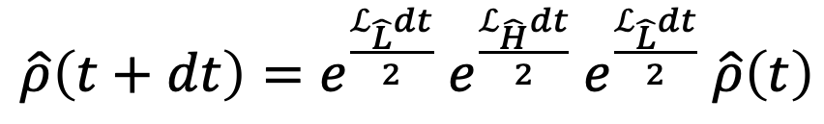
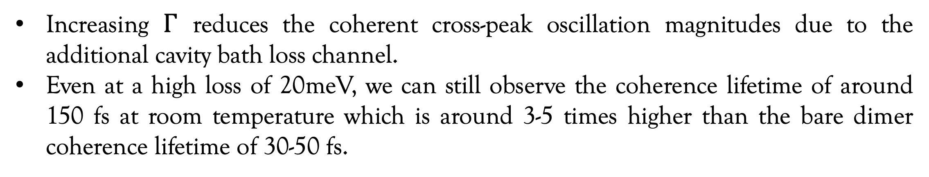
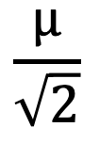
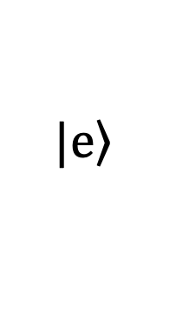
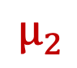
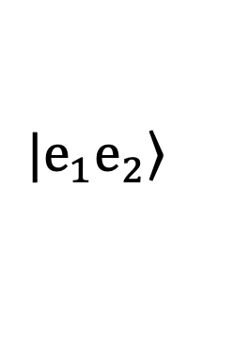
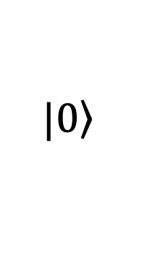
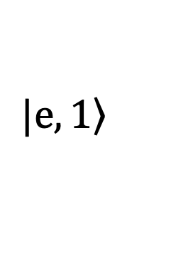
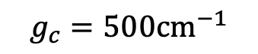
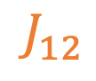
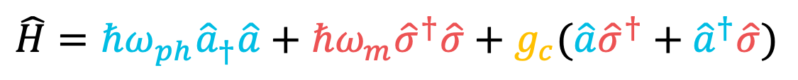
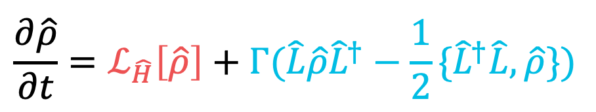
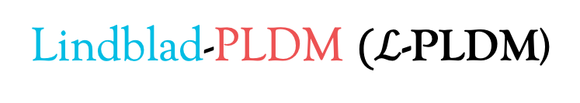
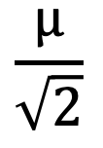
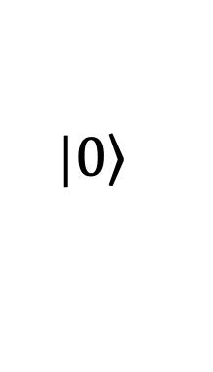
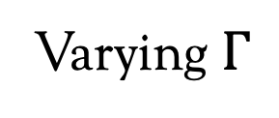

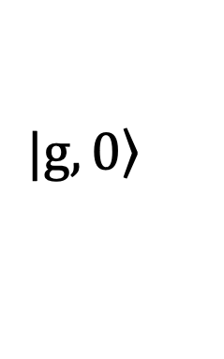
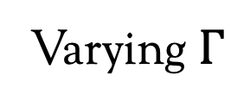
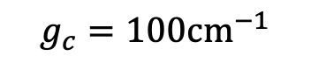
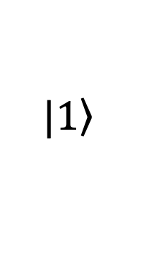
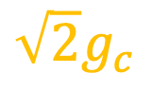
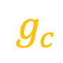
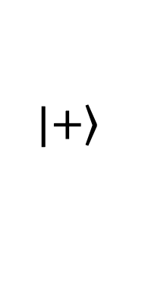



































Quantum Dynamics Simulations of 2D Spectroscopy for Exciton Polaritons
E. Mondal, E. Koessler, J. Provazza, A. N. Vamivakas, S. T. Cundiff, T. D. Krauss, and P. Huo
Department of Chemistry, University of Rochester
Polaritons
Linear Absorption
Coherence Enhancement
When molecules are coupled to a quantized radiation field inside an optical cavity, they produce a set of photon-matter hybrid states known as polaritons. These hybrid states can alter the material properties like enhanced coherence, phonon decoupling, improved transport, and modifying chemical reactivity.
$$g_{c}$$
$$|\left.e,1\right\rangle$$
$$\frac{μ}{\sqrt{2}}$$
Rabi splitting of polariton peaks.
Increase loss rate broadens peaks.
A high cavity loss rate is equivalent to no light-matter coupling.
Rabi splitting increases with increasing $g_{c}$.
$$\left.{|e}_{1}e_{2}\right\rangle$$
$$\sqrt{2}g_{c}$$
Rabi-splitting of upper and lower polaritons is observed but the high bath reorganization obscures the spectral resolution for low $g_{c}$.
An increase in $g_{c}$ improves the spectral resolution between the diagonal and cross-peaks.
Increasing $g_{c}$ improves the coherent mechanism in the system compared to a bare isolated coupled dimer.
$$|\left.e\right\rangle$$
$$|\left.1\right\rangle$$
$$\frac{μ}{\sqrt{2}}$$
$$|\left.+\right\rangle$$
$$μ_{2}$$
$$J_{12}$$
$$μ_{1}$$
$$|\left.2\right\rangle$$
$$μ$$
$$Γ$$
$$|\left.−\right\rangle$$
$$\frac{μ}{\sqrt{2}}$$
$$\frac{μ}{\sqrt{2}}$$
$$\left.{|e}_{1}g_{2}\right\rangle$$
$$2Γ$$
$$|\left.1\right\rangle$$
$$|\left.e,1\right\rangle$$
$$|\left.g\right\rangle$$
$$|\left.0\right\rangle$$
$$μ_{1}$$
$$\left.{|g}_{1}e_{2}\right\rangle$$
$$Γ$$
$$\hat{H}=ℏω_{ph}{\hat{a}}_{†}\hat{a}+{ℏω}_{m}{\hat{σ}}^{†}\hat{σ}+g_{c}(\hat{a}{\hat{σ}}^{†}+{\hat{a}}^{†}\hat{σ})$$
$$|\left.e\right\rangle$$
$$g_{c}$$
$$|\left.1\right\rangle$$
$$|\left.+\right\rangle$$
$$g_{c}=456{cm}^{−1}$$
$$|\left.g,0\right\rangle$$
$$Γ=10meV$$
$$μ_{2}$$
$$g_{c}$$
$$|\left.0\right\rangle$$
$$|\left.±\right\rangle =\frac{|\left.g,1\right\rangle ±\left.|e,0\right\rangle }{√2}$$
$$ω_{m}$$
$$ω_{ph}$$
$${2g}_{c}$$
$$\left.{|g}_{1}g_{2}\right\rangle$$
$$ω_{±}=\frac{ω_{ph}+ω_{m}}{2}±\frac{1}{2}\sqrt{{(ω_{ph}−ω_{m})}^{2}+{4g}_{c}^{2}}$$
$$|\left.g\right\rangle$$
$$|\left.0\right\rangle$$
$$|\left.−\right\rangle$$
(a)
(b)
(c)
$$|\left.g,0\right\rangle$$
$$g_{c}=100{cm}^{−1}$$
Varying${ g}_{c}$
2D-Spectroscopy
$$R^{\left(3\right)}(τ_{1},τ_{2}\text{,}τ_{3})=Tr[μ(τ_{3})[μ(τ_{2}),[μ(τ_{1}),[μ,ρ_{0}]]]$$
(d)
$$g_{c}=200{cm}^{−1}$$
(e)
(f)
Purely absorptive 2DES
Varying $Γ$
Varying $Γ$
Varying${ g}_{c}$
(g)
$$g_{c}=500{cm}^{−1}$$
(h)
(i)
Diagonal peaks → Excitation frequencies
Elongated peaks → Inhomogeneity
Cross peaks → Coupling
Peak oscillations (along $τ_{2}$) → Coherent energy transfer
Increasing $Γ$ reduces the coherent cross-peak oscillation magnitudes due to the additional cavity bath loss channel.
Even at a high loss of 20meV, we can still observe the coherence lifetime of around 150 fs at room temperature which is around 3-5 times higher than the bare dimer coherence lifetime of 30-50 fs.
$ℒ$-PLDM Dynamics
Conclusions
PLDM
Lindblad
We incorporated Lindblad dynamics in the mixed quantum-classical framework of PLDM dynamics for simulating linear and nonlinear spectroscopy of polaritonic systems. Here we treat the non-Markovian feedback of matter bath to the quantum system by PLDM dynamics and the cavity loss is treated within the Markovian Lindblad systems. We can extend this concept to simulate spectroscopy for systems in which there is a separation of Markovianity within certain quantum degrees of freedom.
The trajectory-based nature reduces the computation scaling significantly on High-Performance Computing facilities.
Through simple model calculations, we showed that 2DES simulations can help properly model the coherent mechanisms in polaritonic systems.
$$\frac{∂\hat{ρ}}{∂t}=ℒ_{\hat{H}}\left[\hat{ρ}\right]+Γ(\hat{L}\hat{ρ}{\hat{L}}^{†}−\frac{1}{2}\{{\hat{L}}^{†}\hat{L},\hat{ρ}\})$$
PLDM
$$\hat{ρ}=\sum_{αβ}{ρ_{αβ}\left.|α\right\rangle \left\langle β|\right.}→ρ_{αβ}{\hat{a}}_{α}^{†}{\hat{a}}_{β}$$
Lindblad
$$η_{αξ}=e^{−\frac{Γdt}{2}}$$
$$η_{0ξ}=1+(2r−1)\sqrt{3(1−e^{−Γdt})\frac{ρ_{αα}}{ρ_{00}}}$$
$$ρ_{αβ}\left(t+dt\right)=\frac{1}{N}\sum_{ξ}^{N}{η_{αξ}η_{βξ}ρ_{αβ}\left(t\right)}$$
Upper and lower polariton peaks along the diagonals show Rabi-splitting.
The diagonal peaks are homogenously elongated and with an increase in $Γ$ we see more homogenous broadening due to a homogeneous cavity loss channel.
Oscillations in off-diagonal peak intensities are an indication of coherent energy transfer between upper and lower polaritons.
Increasing $Γ$ cause the signals to decay faster.
An increase in $g_{c}$ causes increased Rabi-splitting and increased coherent transfer.
References
Lindblad-PLDM $(ℒ$-PLDM)
J. Provazza, F. Segatta, M. Garavelli, and D. F. Coker, J. Chem. Theory Comput. 14, 856–866 (2018)
E. Koessler, A. Mandal, and P. Huo J. Chem. Phys. (2022)
P. Huo and D. F. Coker, J. Chem. Phys. 135, 201101 (2011)
$\hat{ρ}\left(t+dt\right)=e^{\frac{ℒ_{\hat{L}}dt}{2}}$ $e^{\frac{ℒ_{\hat{H}}dt}{2}}$ $e^{\frac{ℒ_{\hat{L}}dt}{2}}$ $\hat{ρ}\left(t\right)$
Acknowledgment:
DE-SC0022171
CENTRE
for
INTEGRATED
RESEARCH
COMPUTING

